Slide 1
C Build Process

Slide 2
Content
Model
Preprocessor
Compiler
Assembler
Linker

Slide 3
Model (Executable and Linkable Format)
C Source File
(.c)
Preprocessed
C Source File
(.i)
Assembly
Source File
(.s)
Preprocessor
Compiler
Object File
(.o)
Executable File
(none)
Assembler
Linker

Slide 4
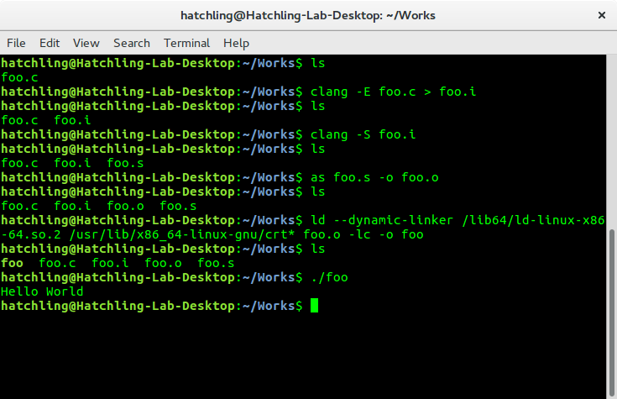
Model (Executable and Linkable Format)

Slide 5
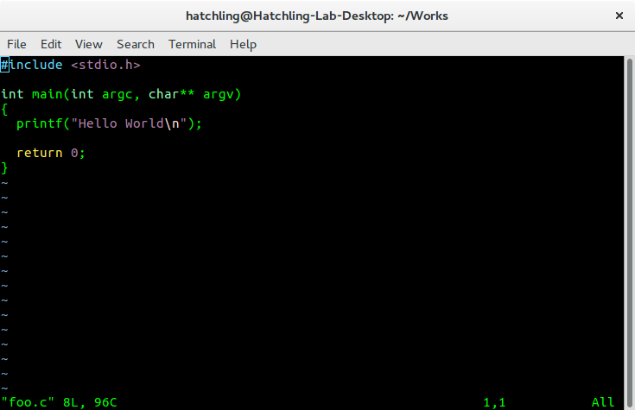
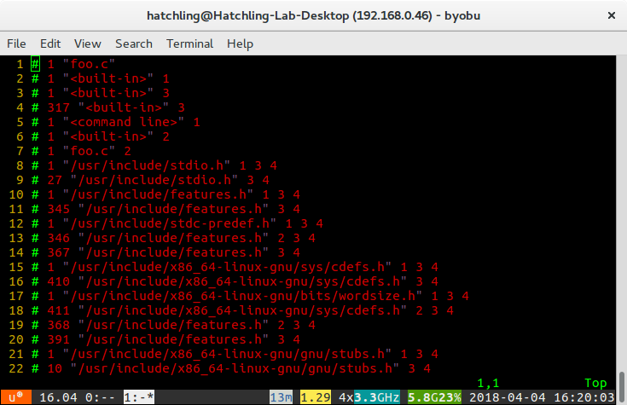
Preprocessor
C Source code(foo.c)
Preprocessed C Source code(foo.i)

Slide 6
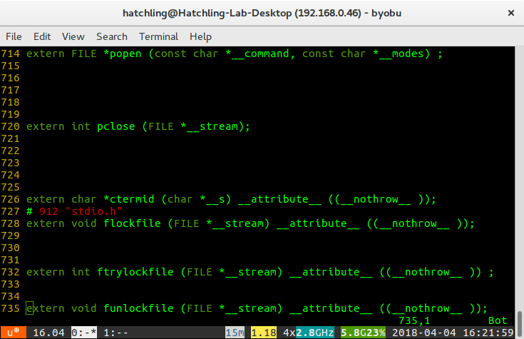
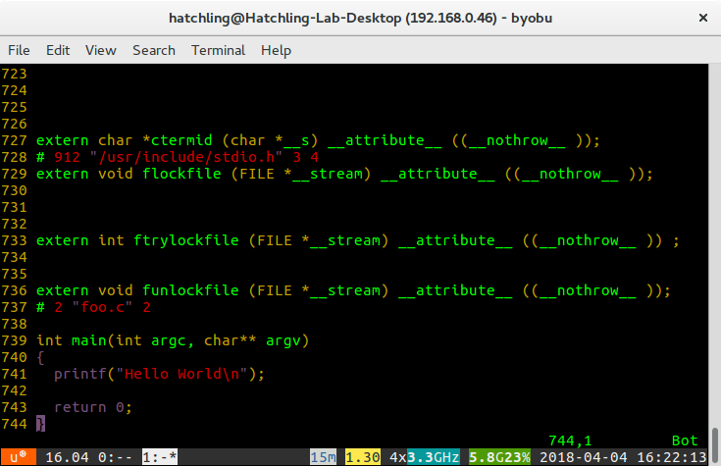
Preprocessor
VS.

Slide 7
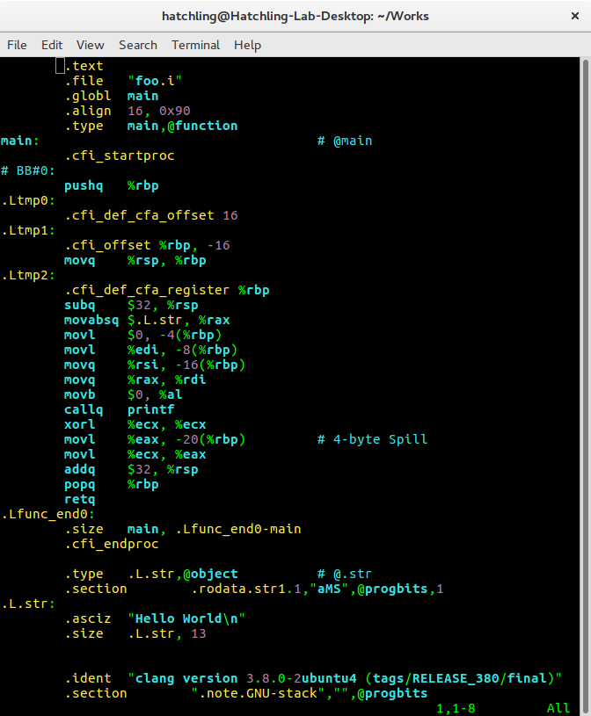
Compiler
.c / .i
.s

Slide 8
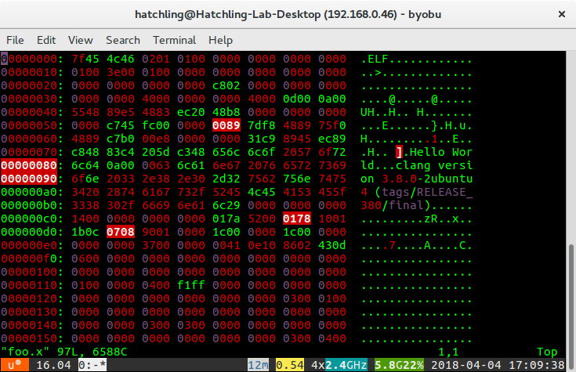
Assembler
.s
.o

Slide 9
Linker

Slide 10
Linker
main() is not the entry point of program; _start() is
crt1.o: contains _start()
crti.o: contains prologue part of __init() and __fini()
crtn.o: contains epilogue part of __init() and __fini()

Slide 11
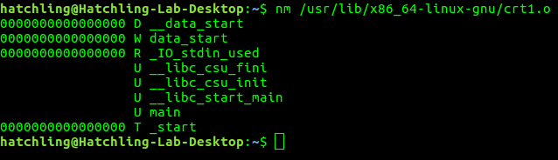

Linker

Slide 12
Function prologue/epilogue
Prologue
Appears at the beginning of a function
Prepares the stack and registers for use within the function
Epilogue
Appears at the end of a function
Restores the stack and registers to previous state(before the function call)
- Terms in assembly language programming

Slide 13
Executable

